Slide 1
MVC
(Model – View – Controller)
by İbrahim Esen

Slide 2
Purpose
Commonly used, powerful architectural pattern for GUI
Seperation of domain logic from presentation
Reuse business model behaviors
First in 1979 on Smalltalk at Xerox labs

Slide 3
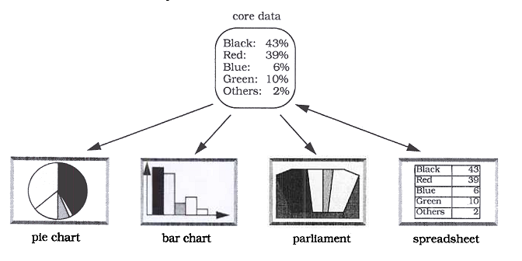
Motivation
Same data, various presentations

Slide 4
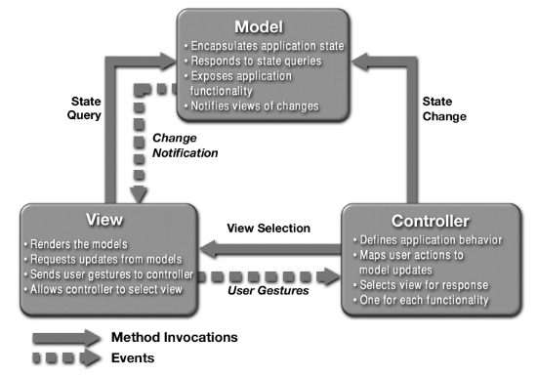
Structure

Slide 5
Model
Manage Information
Responds to queries
Expose business functionality
Notify views of changes
Observer pattern or Push & Pull methods

Slide 6
View
Display user interface components
Renders the content of the model
Consistent with model via notifications
Associated with a controller

Slide 7
Controller
One-to-one relationship with view
Accepts user input as events
Translates events to business processes
Select appropriate view
May participate in view update procedure

Slide 8
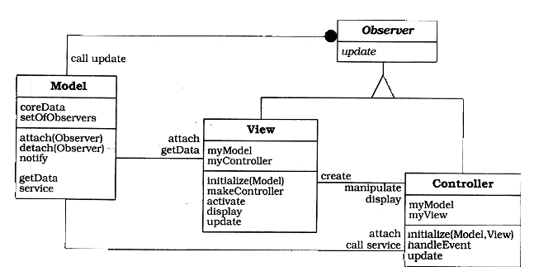
Notification using Observer

Slide 9
Examples
Various GUI frameworks
Java Swing is a good example

Slide 10
Other Implementations
Java EE Technologies
Model – Classes, EJBs
View – JSP Pages, HTML files (for JSF Facelets)
Controller – Servlet, JSF Managed Beans
Cocoa
Adobe Flex
MFC
ASP.NET MVC
...and many more

Slide 11
Pros
Multiple views of the same model
View in sync via notifications
Pluggable views and controllers

Slide 12
Cons
Increased design complexity
Unnecessary view updates
Close coupling of view and controller to model
Method calls on model
Can be solved by Command pattern

Slide 13
References
http://java.sun.com/blueprints/patterns/MVC-detailed.html
http://en.wikipedia.org/wiki/Model%E2%80%93view%E2%80%93controller
Pattern-Oriented Software Architecture Volume 1: A System of Patterns
http://www.amazon.com/Pattern-Oriented-Software-Architecture-System-Patterns/dp/0471958697

Slide 14
Questions ?

